Slide 1



Banking Bot: A Modern Solution for Financial Needs
Traditional banking methods can be time-consuming and inconvenient. A banking bot can provide a modern and efficient solution.

Slide 2


The Problem: Inefficient Banking
1
Long Wait Times
2
Limited Hours
Customers often face long wait times at bank branches or on phone lines.
Bank branches have limited operating hours, making it difficult for customers with busy schedules.
3
Complex Processes
4
Lack of Personalized Support
Many banking tasks require multiple steps and can be confusing for customers.
Customers may not receive the personalized support they need when dealing with their finances.

Slide 3


The Solution: A Banking Bot
24/7 Availability
Personalized Support
A banking bot is available anytime, anywhere, providing immediate access to banking services.
A banking bot can tailor responses and provide personalized guidance based on individual needs.
Automated Tasks
Enhanced Security
Bots can automate routine tasks like balance inquiries, transfers, and bill payments, saving time and effort.
Banking bots can leverage advanced security measures to protect sensitive financial data.

Slide 4
Introduction to Banking Bots
AI-Powered
Natural Language Processing
Integration with Bank Systems
Banking bots are powered by artificial intelligence (AI), enabling them to understand and respond to user inquiries.
Bots use natural language processing (NLP) to understand and interpret human language, allowing for seamless communication.
Banking bots are integrated with bank systems, allowing them to access and process real-time financial data.

Slide 5

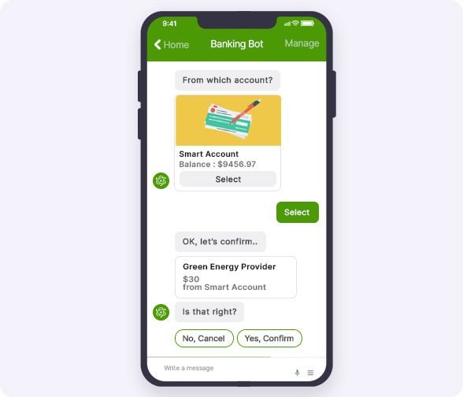
Advantages of a Banking Bot
1
Increased Efficiency
Bots can handle high volumes of requests, reducing wait times and improving customer satisfaction.
2
Enhanced Customer Experience
Personalized support and 24/7 availability create a more convenient and positive experience.
3
Cost Reduction
Automating tasks reduces the need for human agents, lowering operational costs for banks.
4
Data Analytics
Bots collect valuable data on customer interactions, providing insights for improving products and services.

Slide 6


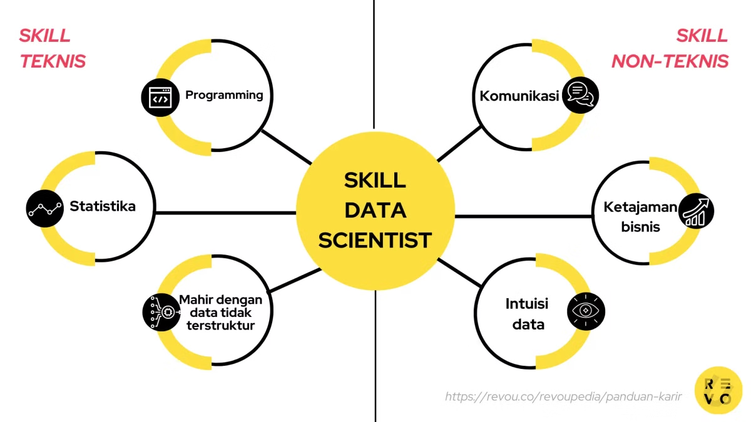


Feasibility of Implementing a Banking Bot
Technical Infrastructure
Banks need to ensure they have the technical infrastructure to support a bot's operations.
Data Security
Implementing robust security measures is crucial to protect customer data from unauthorized access.
Customer Education
Banks need to educate customers on how to use the bot and address any concerns they may have.

Slide 7


Future Scope of Banking Bots
Advanced AI
Further advancements in AI will enable bots to provide even more personalized and sophisticated services.
Integration with Other Platforms
Bots will seamlessly integrate with other financial platforms, offering a comprehensive solution.
Voice Assistants
Bots will leverage voice assistants, allowing customers to interact with their banking services through speech.

